Slide 1


Welcome to my class

Slide 2

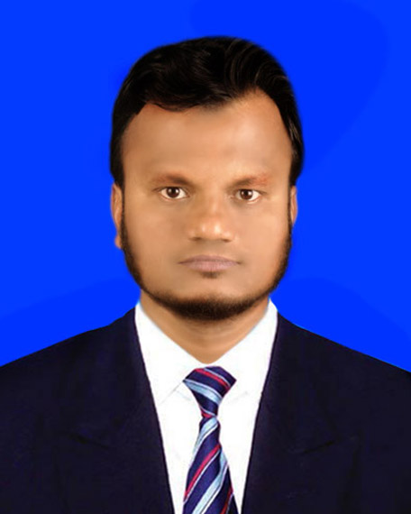

Introduction
Md. Mohsin Miah
Asst. Teacher, English
Bara Gobindapur AMB High School
Chandina, Comilla.
mmmntc82@gmail.com

Slide 3

Let’s enjoy a video
Notes:
The students will watch the movie and introduce with our cultures at a glance.

Slide 4


What have you seen in the video?
Class –nine,
Sub- English 2nd paper.
Time- 60 Minutes
Paragraph writing: Today our topic is “A Book Fair.”

Slide 5


Outcome
After the end of the lesson, the students will be able be-
*introduce with a book fair
*interest to visit a book fair
*to buy new books
*learn how to a paragraph.

Slide 6
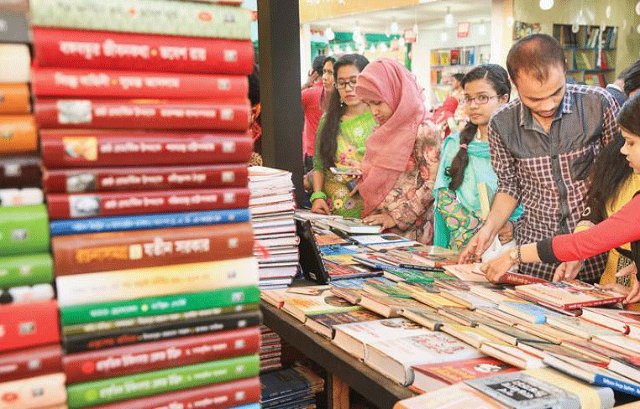
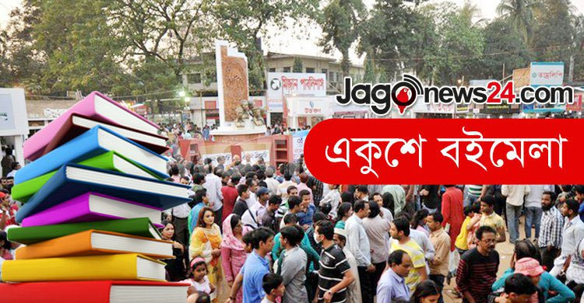

What do you see in the pictures?
The Book Fair in Bangla Academy Premises.

Slide 7


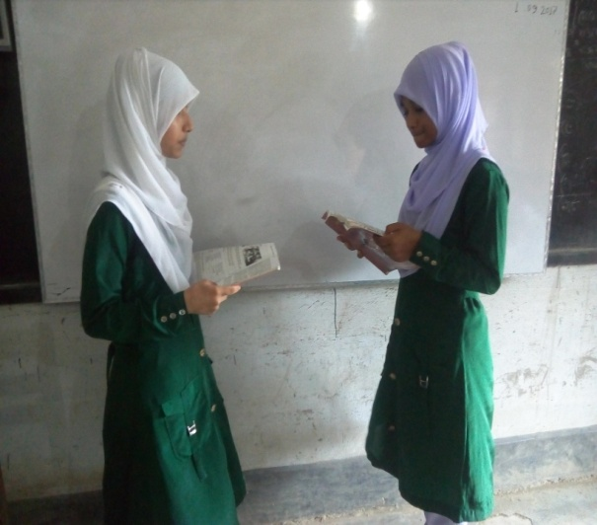
Pair Work
Questions:
What have you seen in the previous slides?
What do they about?
Why is it held?
Which is the biggest book fair in BD?

Slide 8
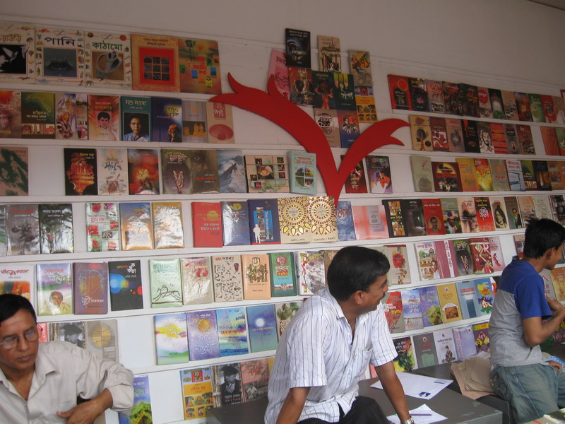
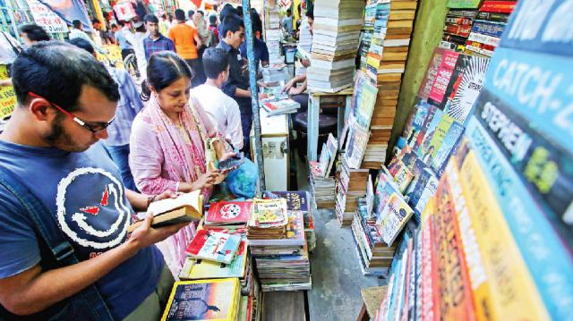
What is a book fair?
Book Fair
A book fair is a place where different types of book are displayed.

Slide 9

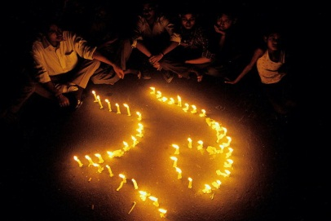
Where is the biggest book fair held and why?
The biggest book fair is held in Bangla Academy premises as a memory of language movement for one month.

Slide 10
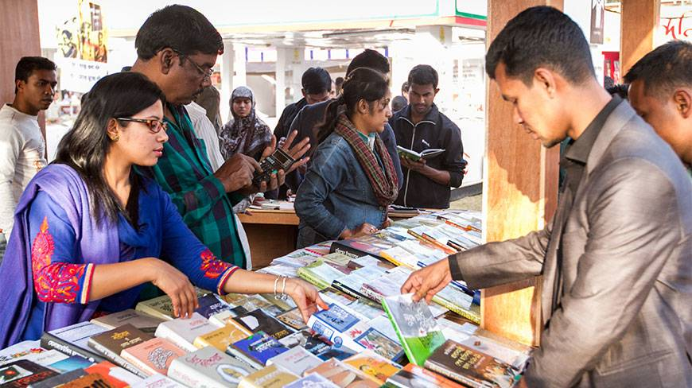
What do the people do in a book fair?
People remain choosing and buying their desired books.

Slide 11
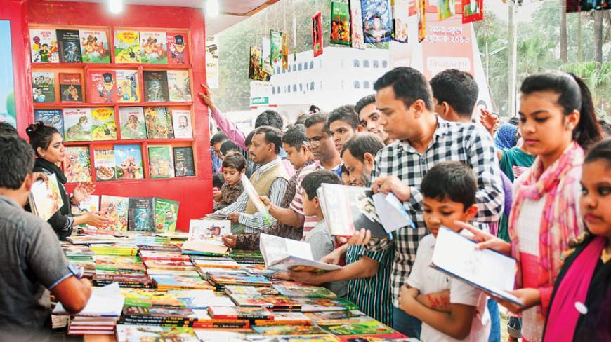
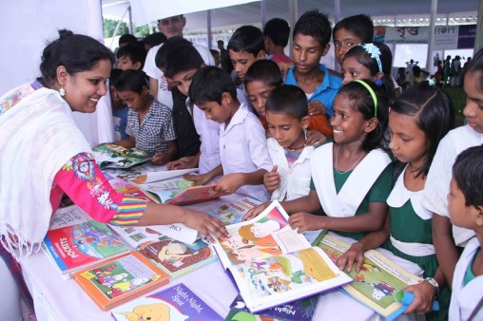
What do you see in the pictures?
Man and with their children are in the fair
School children are choosing their books.
Notes:
The teacher will ask the students about the images and students will make conversation on them.

Slide 12

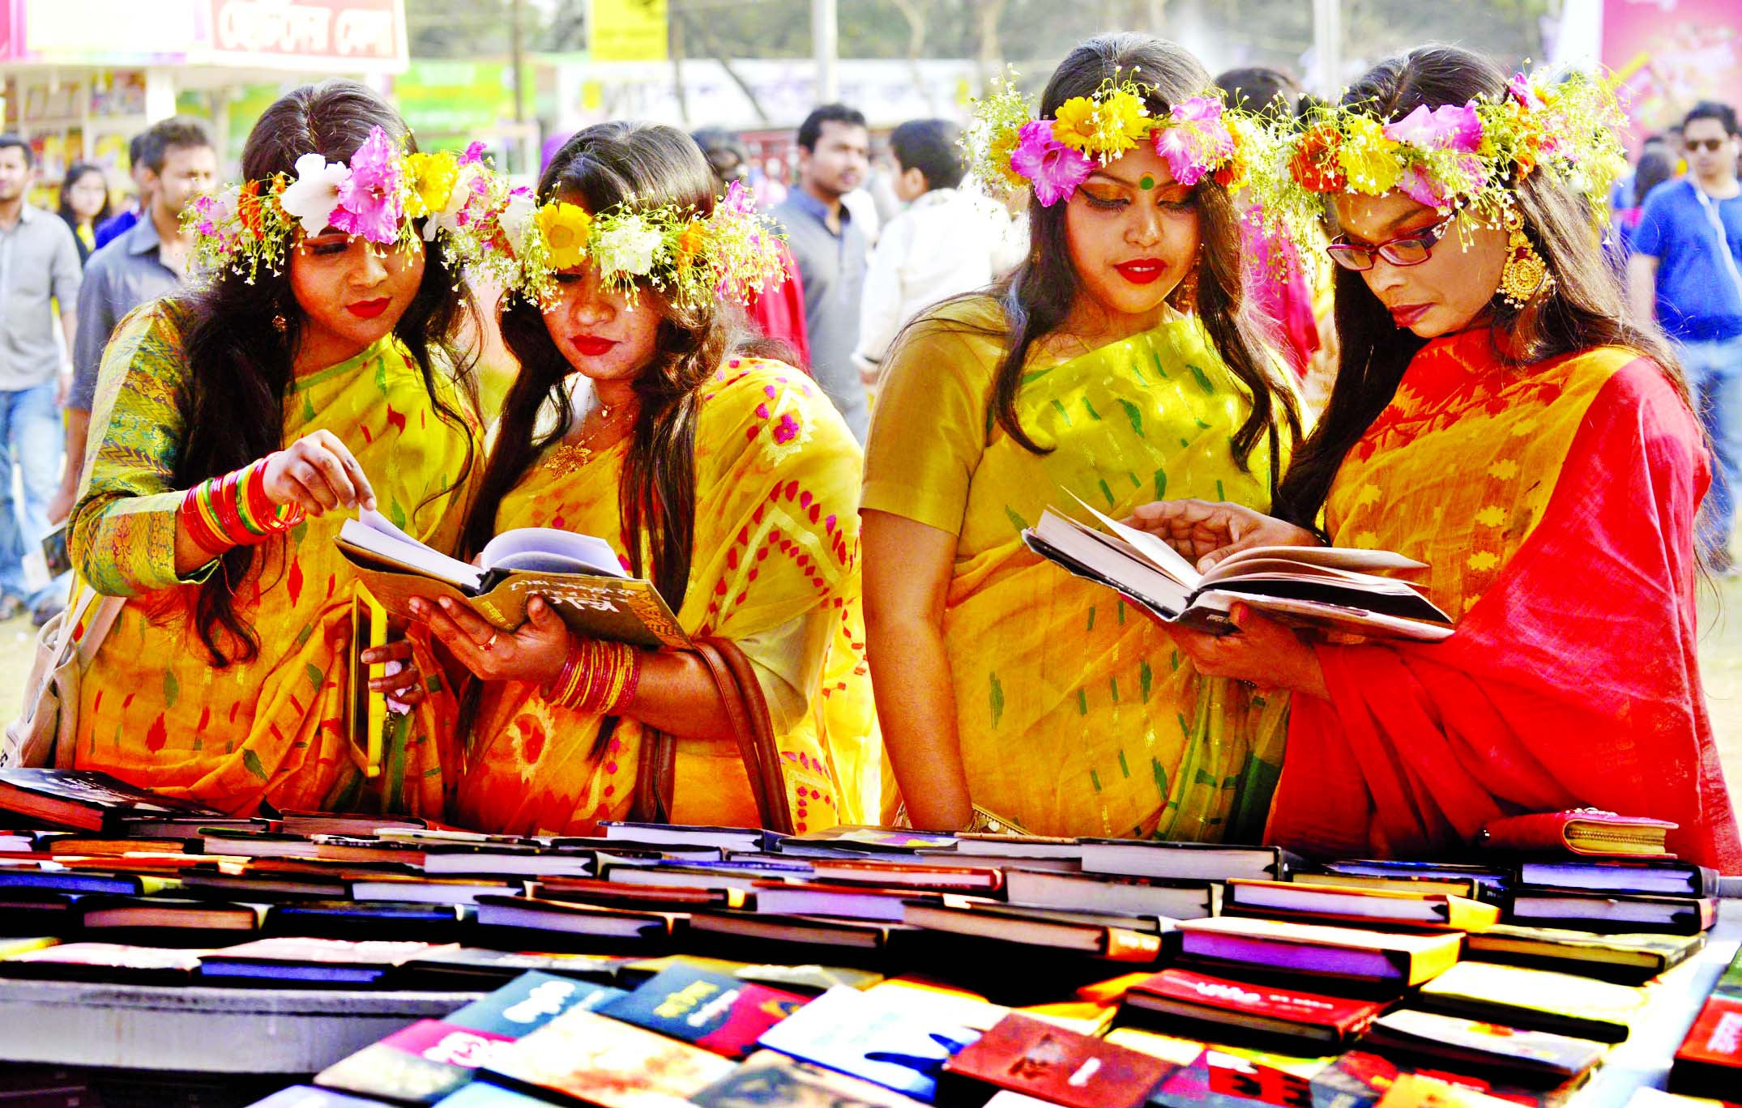
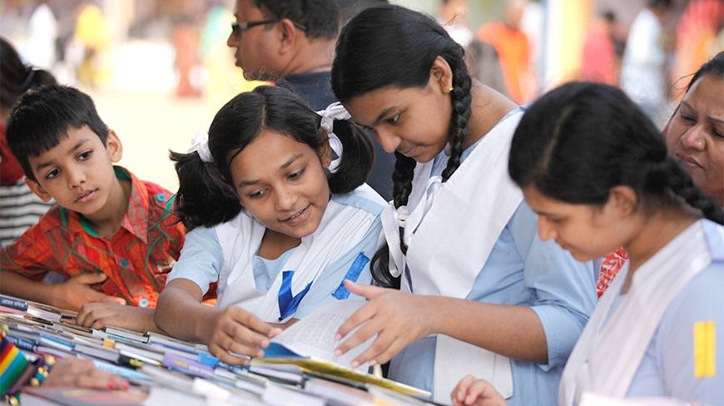

What do you see in the pictures?
The universities students with traditional dresses are in the book fair
School students are in the book fair

Slide 13
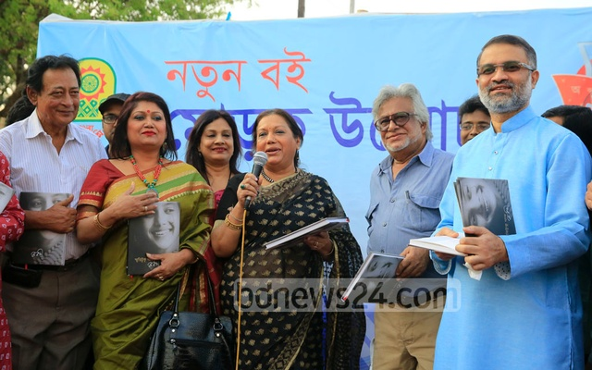
What do understand by the pictures?
It is a program of new book uncovering.

Slide 14
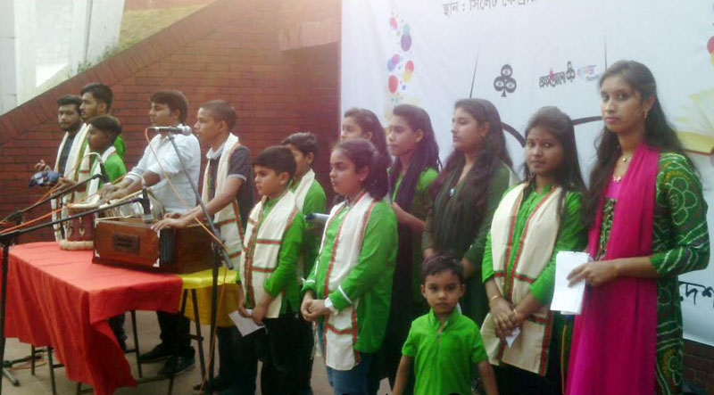
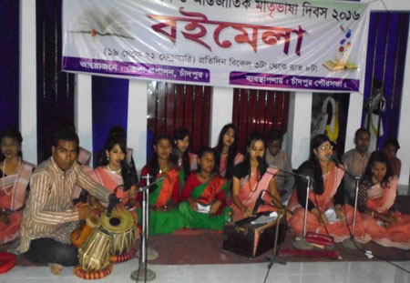
What do you see in the pictures?
In the evening, the cultural program is held in the book fair.

Slide 15
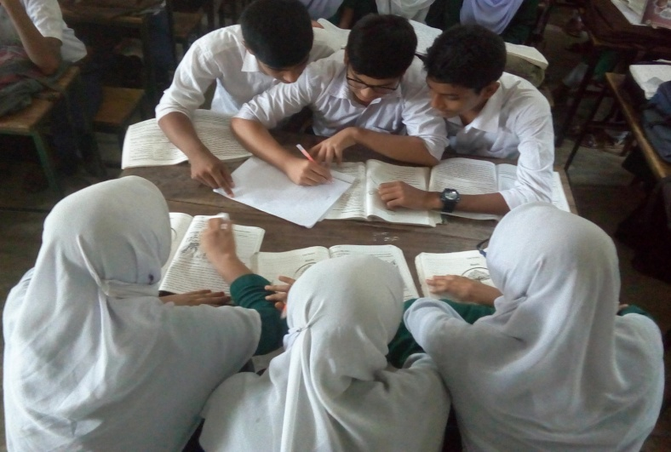
Group Work
What is a book fair?
Why is the book fair held?
What do the visitors do in the fair?
Who gather in the book fair?
Why are the writers/poets go there?

Slide 16


Evaluation
Questions:
What is a book fair?
What can you see going to a book fair?
Why do the students gather in the book fair?
When is the cultural program held?

Slide 17

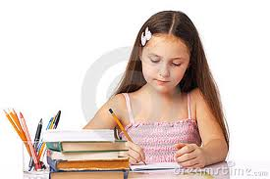
Home Work
Write a paragraph in about 100-120 words on “A Book Fair.”

Slide 18


Good bye

